Slide 1
هوش محاسباتی:
شبکه های عصبی مصنوعی
دانشكده مهندسي كامپيوتر
دانشگاه علم و صنعت ايران
ناصر مزيني mozayani@iust.ac.ir
مدل RBF

Slide 2
Radial Basis Functions

Slide 3
Introduction
BP & MLP can be viewed as optimization under supervision
Generalization means interpolation of new points
Problem of function approximation or curve fitting
➔ RBF is another solution for this problem

Slide 4
RBF’s history
-first introduced in interpolation problem in numerical analysis (Powell 1985)
-using RBF in ANN (Broomhead & Lowe 1988,
Moody & Darken 1988,…)
-some basis functions are defined for input patterns

Slide 5











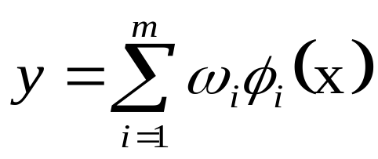

Architecture
…...
…..
  Weights of the input layer are all “1”,
  All basis functions are “radial”:

Slide 6
RBF (cont’d)
Each hidden neuron in an RBF is tuned to respond to a rather local region of feature space by means of a radially symmetric function
Mapping:
  nonlinear mapping form input to hidden neurons
  linear mapping from hidden neurons to outputs

Slide 7
Cover’s Theorem
Cover’s Theorem(Cover, 1965):
A complex pattern classification problem cast in a high dimensional space nonlinearly is more likely to be linearly separable than in a low dimensional space
Cover’s Theorem in Practice:
A non-linear hidden layer
Large dimensionality for the hidden layer compared to the input space

Slide 8
Separability
Functional Separability:
Linearly Separable
Spherically Separable
Quadrically Separable
x
x
x
o
o
o
x
x
x
o
x
o
x
o
x
o
Polynomial separability is a natural extension of linear separability

Slide 9
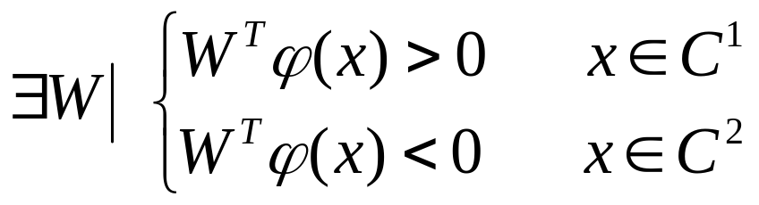
Separability (cont’d)
X¹, X², …,X^{P} assigned to two classes C¹ C²
φ–separability:
Cover’s Corollary:
The expected maximum number randomly assigned patterns that are linearly separable in an input space is double the dimensionality of that space
By displacing center of radial functions, we may reduce the dimensionality of hidden neurons

Slide 10
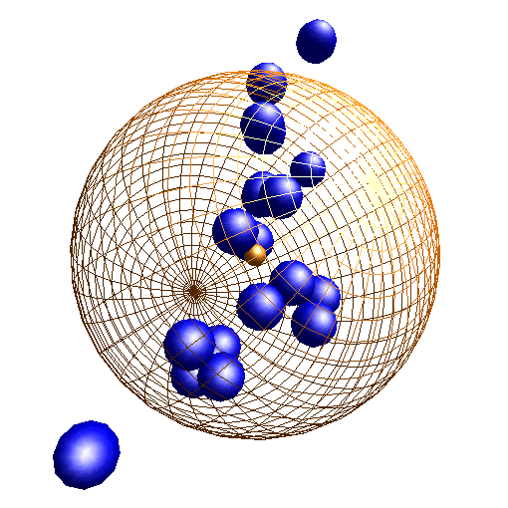
Activation
Activation of a hidden unit is determined by the DISTANCE between the input vector x and a prototype vector t
φ_{j}(x)=f(|x- t_{j}|)
x is a multidimensional input vector
t_{j} is a vector with same dimension as x
φ_{j}(.) is the j^{th} radial basis function with a single maximum at the origin
σ

Slide 11
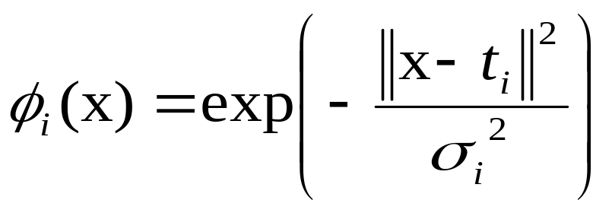

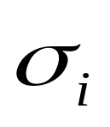
Activation (cont’d)
Choice of radial basis:
Although several forms of radial basis may be used (uniform, etc.), Gaussian kernels are most commonly used:
    Coordinates of center:
    Width parameter:

Slide 12

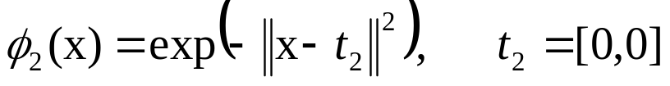
Example : XOR
We need a classifier to respond 1
for (1,0) and (0,1) samples and
respond 0 for (1,1) and (0,0).
(0,1)
(1,1)
(0,0)
(1,0)
We define:
σ is considered 1 in this example.
We obtain:
Input x | Φ₁(x) | Φ₂(x)
(1,1) | 1 | 0.1353
(0,1) | 0.3678 | 0.3678
(0,0) | 0.1353 | 1
(1,0) | 0.3678 | 0.3678

Slide 13
Other points
Learning is finding surface in multidimensional space best fit to training data
Approximate function with linear combination of Radial basis functions
F(x) = Σ w_{i} G(||x- t_{j}||) i = 1, 2, … , N
G(||x- t_{j}||) is also called Green function
When N= number of samples, we call it regularization network
When N < number of samples, Radial-basis function network
It can be shown that we need at least: N=1/2 no of samples

Slide 14
Other points
The degree of generalization is controlled by σ
It requires holding out a validation sample,
training networks with various values of σ and measuring the validation error of each network to see which generalizes best
Make number of parameters small as possible
  Principles of Dimensionality

Slide 15
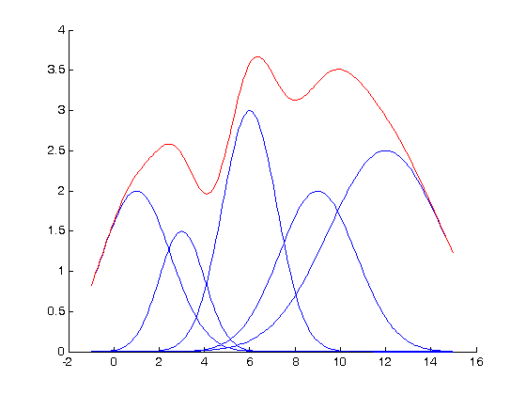
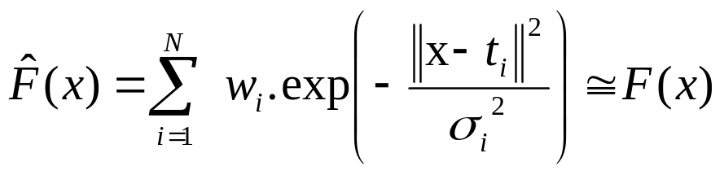
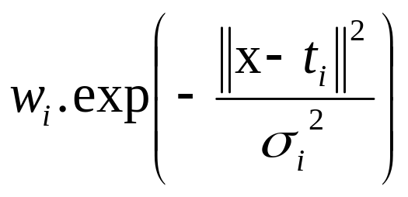
representation
A 1-D graphical representation of Kernel Smoothing with the Spherical Gaussian Functions

Slide 16
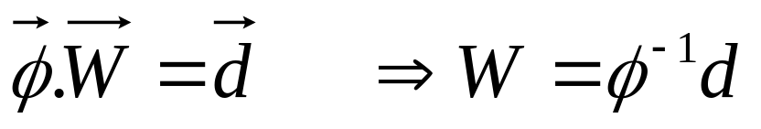
Learning Strategies
Two levels of Learning
  Center and spread learning (or determination)
  Output layer Weights Learning
Theoretically we can obtain output weights by:
But in practice, it is usually a difficult task

Slide 17
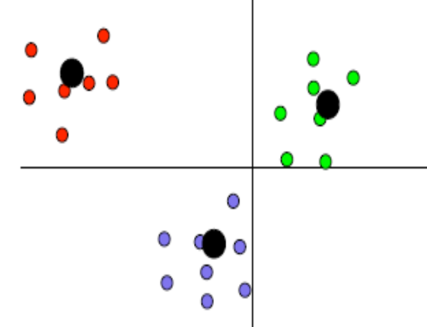
Selection of centers
Fixed Centers
  A quick solution is to place one of the hidden units at the location of every J^{th} example (randomly selected), where J is the number of hidden units
  Another approach is to add nodes successively, until the approximation is good
  In the limit, this might be one node per training pattern
Self-organizing selection of Centers
  clustering first : k-nearest
  neighbors

Slide 18
Selection of spreads
Spreads
  One way is to set the width parameter for all units to the same value , which is the average of the distances from each center to its nearest neighbor
Supervised selection of Centers with weights
  Error correction learning

Slide 19
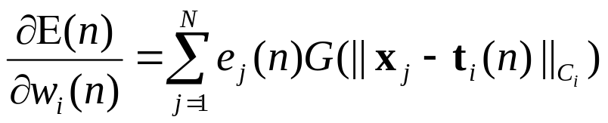
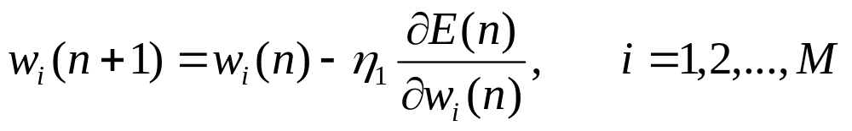
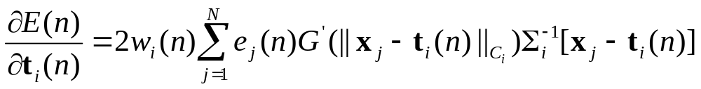

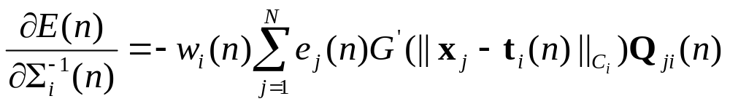
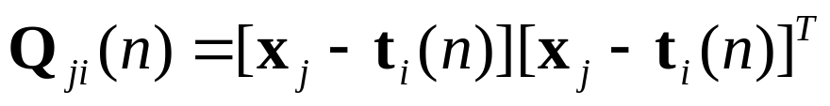
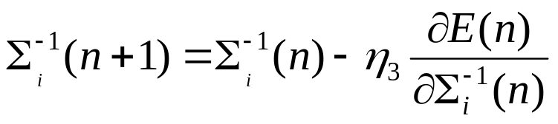
RBF supervised learning
Linear weights
(output layer)
Positions of centers
(hidden layer)
Spreads of centers
(hidden layer)

Slide 20
Training with Noise
Noise in the training set can be good; it
can make the resulting network, which has learned to “average” noise in, more robust
However, with too many neurons, a network can over-train to “learn the noise”

Slide 21
Regularization or Weight Decay
Weight Decay method can be used:
prune an RBF:
  At each update, a small amount is deducted from each weight
  Weights that are constantly being updated will end up with a non-0 value, while others will go to 0 and can be eliminated
  The resulting network is less trained to the noise
Weight Decay is also known as “regularization”

Slide 22
MLP vs RBF
Network structure
  MLP : shares common neuron model
  RBF : output and hidden layer different function
Hidden node computation
  RBF : Euclidean norm
  MLP : inner product
Approximation to non-linear input-output mapping
  MLP : Global
  RBF : Local
    fast, insensitive of order of sample data
    need large data to get smooth surface

